Slide 1
Mojave Groundwater Bank
January 2026

Slide 2
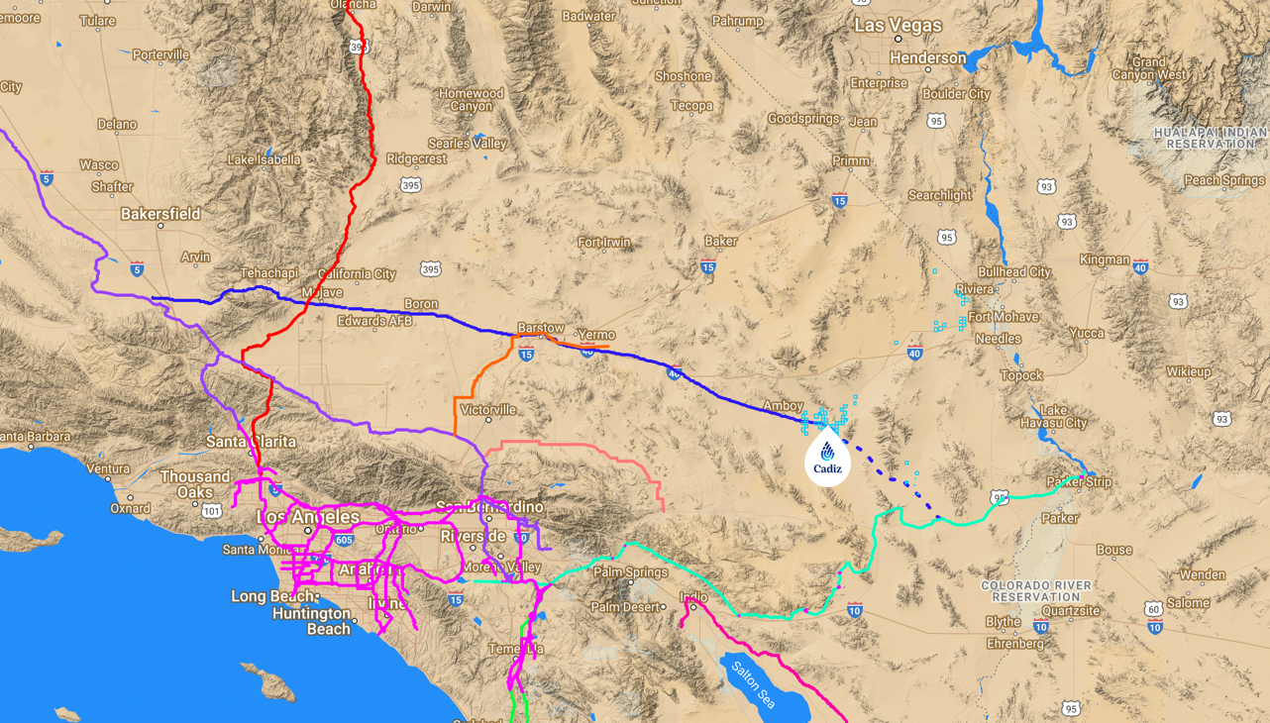


San Bernardino County One Water Projects
Northern Pipeline (NPL)
Reach 1 - Water supply to Baja/Centro groundwater recharge basins / storage
Reach 2 – Water supply to / from AVEK to Barstow
Reach 3 – Water supply from California Aqueduct access to Antelope Valley Hi Desert Water Bank
Mojave Groundwater Bank
Hydrogen / Solar
VVWRA One Water
New recharge basins; stormwater capture, & groundwater storage
Groundwater Treatment (Nitrates, Perchlorates, PFAS
MRP South flow to East Branch
Expanded recycling / distribution
San Bernardino Valley
Fontana / Rialto / Cucamonga
Advanced treatment facilities
Groundwater recharge / storage
Cactus Basin Recharge – Perchlorate
Chino Basin Program
Local distribution pipelines
Southern Pipeline (SPL)
43-mile pipeline system to Colorado River Aqueduct (CRA)
Potential future pipeline development through Morongo Valley for groundwater recharge /storage

Slide 3
30 years of COMPREHENSIVE environmental analysis under NEPA & CEQA
Environmental Review | Lead / Agencies | Decision
1985 All American Pipeline EIS/EIR | BLM & Cal. State Lands Comm. | Extensive environmental analysis supported approval of 1,200-mile buried pipeline to transport crude oil from California to Texas. The pipeline was subsequently sold to EPNG and converted to gas in 2002.
1993 Cadiz Valley Agricultural Development EIR | San Bernardino County | Extensive environmental analysis supported permit for <50,000 acre-feet per year (AFY) groundwater to support agricultural development. Finding of no significant environmental impacts.
1999-2002 Cadiz Groundwater Storage and Dry-Year Supply Program EIS/EIR | BLM & Metro. Water District of S. Cal. | Extensive environmental analysis / public comment supported amendment of California Desert Conservation Area Plan and authorization of a ROW for new pipeline to convey water from Cadiz to Colorado River Aqueduct. The ROD concludes the water project and Groundwater Monitoring and Management Plan will result in no significant environmental impacts.
2005 All American Pipeline Conversion EA/EIR | BLM & Cal. State Lands Comm. | Extensive environmental analysis, resulting in a finding of no significant environmental impacts, approval of a ROW amendment converting El Paso Natural Gas pipeline from crude oil to natural gas.
2011-2012 Cadiz Valley Water Conservation, Recovery, and Storage Project EIR | Santa Margarita Water District / San Bernardino County | Comprehensive environmental analysis (2,937-page DEIR; 1,668-page FEIR) and public comment of the Cadiz Project concluded that the project would result in no significant environmental impacts.
2012 Groundwater Management, Monitoring, and Mitigation Plan For Cadiz Groundwater Conservation, Recovery and Storage Project | San Bernardino County | Extensive Groundwater Monitoring & Management Plan provides binding measures that monitor and mitigate physical effects of the Project to ensure that Project will be conducted with no significant adverse impacts to critical resources and Undesirable Results attributable to the Project.
2014, 2016 – 9 CEQA litigation cases filed challenging the EIR, GMMP, CEQA process | Calif. Superior Court, Calif. Fourth District Court of Appeals | 2014 Superior Court denies all claims brought by litigants NPCA, Sierra Club & CBD et al and upholding the EIR, the groundwater management plan and jurisdiction of lead agencies. 2016 Appellate Court unanimously denies all claims by litigants and upholds all trial court decisions.
2019 Cadiz Valley Water Conservation, Recovery, And Storage Project Addendum To The 2012 Environmental Impact Report | Fenner Valley Water Authority | Supplemental analysis including studies that were released since certification of the 2012 EIR relating to the local natural springs. The Addendum concludes there would be no significant environmental impacts to the natural springs.
2020 El Paso Natural Gas ROW Renewal CatEx | BLM | 5-year environmental review of renewal of El Paso Natural Gas pipeline ROW found no significant impacts.
2023 Assignment of EPNG ROW to Cadiz- CatEx | BLM | August 4, 2023, Proposed Decision 12-month environmental review of assignment of EPNG pipeline ROW to Cadiz found no significant environmental impacts

Slide 4
Extensive Technical Analysis
Title | Author | Summary
2002 Biological Opinion on the Cadiz Groundwater Storage and Dry Year Supply Program | US Dept of Fish & Wildlife | Metropolitan Water District would implement a groundwater monitoring and management plan to ensure that no adverse impacts occur to nearby aquifer system, springs within the affected watersheds, brine resources on Bristol and Cadiz Dry Lakes and air quality in the surrounding Mojave Desert region.
2008 Lawrence Livermore National Lab | LLNL Davisson and Rose | LLNL researchers replicated USGS modeling using site-specific precipitation and estimated 30,000 AFY recharge rate using elevation/precipitation curves; 16,000-29,000 AFY recharge using Maxey Eakin model; 11,000-33,000 using isotopic data analysis.
2010 Study of Cadiz Groundwater Conservation and Storage Project | CH2M HILL | To address discrepancies in recharge estimates, CH2M Hill conducted additional analysis using updated USGS models and site-specific field data that estimated the watershed contains 17-34 million acre-feet in storage, is naturally recharging at 32,500 acre-feet per year.
2012 Quantifying Evaporative Discharge from Bristol and Cadiz Dry Lakes | Desert Research Institute / CH2M Hill | 2011 DRI collected evaporation data at the Bristol Dry Lake and Cadiz Dry Lake estimating evaporation rates from Bristol and Cadiz Dry Lake at approximately 7,860 and 23,730 acre‐feet per year, respectively, for a total combined evaporation rate of 31,590 acre‐feet per year. The report was incorporated into the 2012 FEIR as Appendix L2.
2018 Updated Assessment of Cadiz Water Project Potential Impact on Bonanza Springs | Miles Kenney, Ph.D. and Terry Foreman, CHG | Field study concluding that the fractured rock aquifer supporting creating Bonanza Springs was created by fault zones and is separated by more than 1,000 feet from the alluvial aquifer in the Fenner Valley groundwater basin. Data were peer reviewed and confirmed by 10 scientists.
2018 and 2019 Peer Reviews of Studies Regarding Recharge and Water Sources of Mojave Desert Springs Near Cadiz Water Project | David K. Kreamer, Ph.D. UNLV | Peer-review of prior studies suggesting possible hydraulic connection between Bonanza Spring aquifer and groundwater in Fenner Valley aquifer. Bonanza Spring and Cadiz are separated by 11 miles and over1,400 feet of elevation, and are hydrologically separated by fault zones that act as barriers between the spring and alluvial aquifer; concluding that Bonanza Spring is fed from rainfall, not connected to the aquifer.
2019 Independent Peer Review Panel for the GMMMP for the Cadiz Project | Aquilogic et al. | Independent peer review prepared by Three Valleys MWD concluded that the GMMMP (1) provided sufficient management and monitoring to identify any Undesirable Results that could occur in response to proposed groundwater pumping as part of the Cadiz Project; and (2) provided effective Corrective Measures (i.e., mitigation) sufficient to avoid any significant environmental impacts.
2024/25 PRISM Precipitation Data and Precipitation Trends in the Greater Fenner Watershed | GeoScience Support Services Inc. | Tech Memo to GMMMP’s Technical Review Panel (TRP) providing a compilation of precipitation data for the groundwater basins within the Greater Fenner Watershed, including Bristol, Fenner, and Cadiz Groundwater Basins. These data include recent PRISM precipitation data.

Slide 5
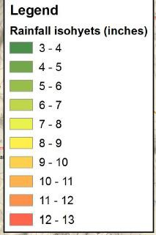
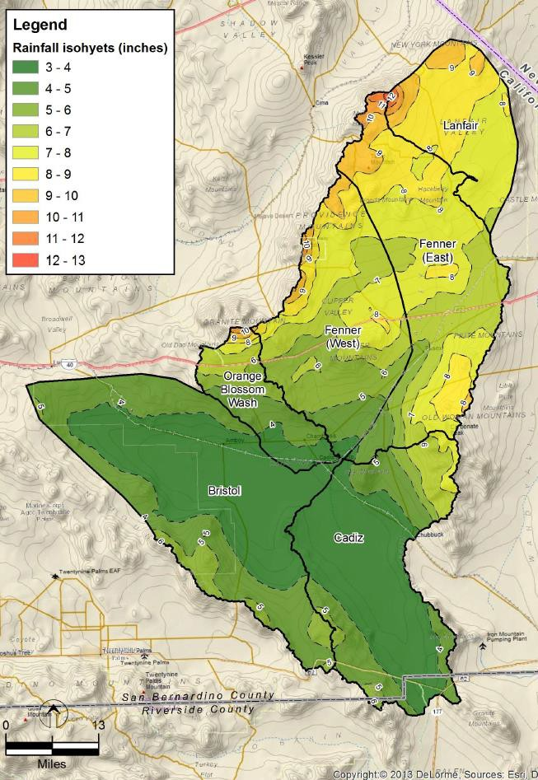
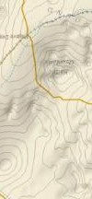

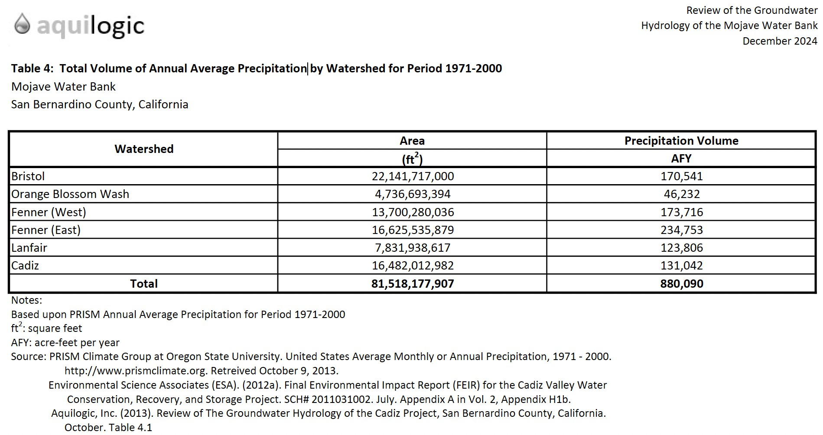
Precipitation Volume for Watersheds in the Mojave Groundwater Bank
Eastern Mojave is Not in the Rain Shadow of the Sierras.
9-13 inches per year above 4,000 ft elevation (New York and Providence Mountains)

